Slide 1
Chapter 9
Introduction to High-Level Language Programming

Slide 2
Learning Objectives (1 of 2)
Explain the advantages of high-level programming languages over assembly language
Describe the general process of translation from high-level source code to object code
Name the five procedural programming languages used in the examples of this chapter
Explain the favorite number and data cleanup examples for each programming language

Slide 3
Learning Objectives (2 of 2)
Explain why the software development life cycle is necessary for creating large software programs
List the steps in the software development life cycle, explain the purpose of each, and describe the products of each
Explain how agile software development differs from the traditional waterfall model

Slide 4
The Language Progression (1 of 4)
Assembly language improves on machine language
Assembly language disadvantages
Programmer must manage movement of data among memory locations and registers
Microscopic view of the task
Machine specific language
Very different from natural language

Slide 5
The Language Progression (2 of 4)
High-level programming languages improve on assembly language
Expectations
Programmer need not manage data within memory
Macroscopic view of tasks (e.g., “add B and C”)
Programs are portable from one machine to another
Programming statements are closer to natural language and use mathematical notation
Third-generation languages

Slide 6
The Language Progression (3 of 4)
Need a translator for high-level languages
Compiler converts source code to assembly language or similar language
Assembler or other converter makes object code
Code libraries contain object code for tasks
Linker integrates multiple files of object code to create an executable module

Slide 7
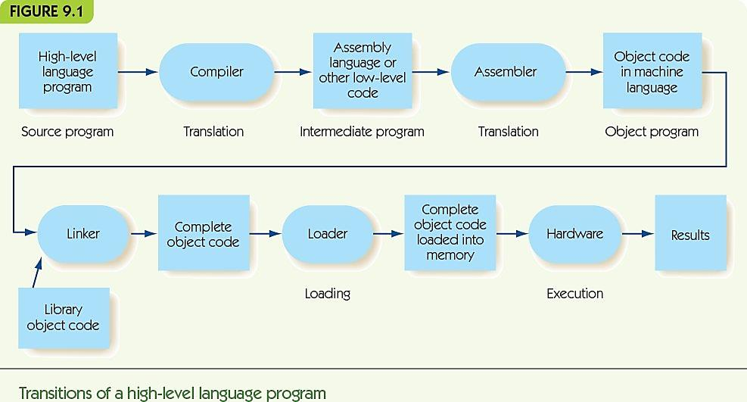
The Language Progression (4 of 4)

Slide 8
A Family of Languages
Procedural (imperative) languages
Popular kind of programming language
Programs are sequences of statements
Examples: Ada, C++, C#, Java, and Python
Same underlying philosophy or model
Variations in
Syntax: how statements are written
Semantics: meaning of statements

Slide 9
Two Examples in Five-Part Harmony (1 of 8)
Examine similarities and differences of the languages (Ada, C++, C#, Java, and Python) through examples
Favorite Number
Ask user for her favorite number and then tell her that your favorite number is one greater than hers
Data Cleanup
Converging-pointers algorithm from Chapter 3

Slide 10
Two Examples in Five-Part Harmony (2 of 8)
First example: Favorite Number
Simple program, no loops or conditionals
Focus on input/output, variable creation and assignment
FIGURE 9.2
Get value for the user’s favorite number, n
Increase by 1
Print a message and the new value of n
Pseudocode algorithm for favorite number

Slide 11
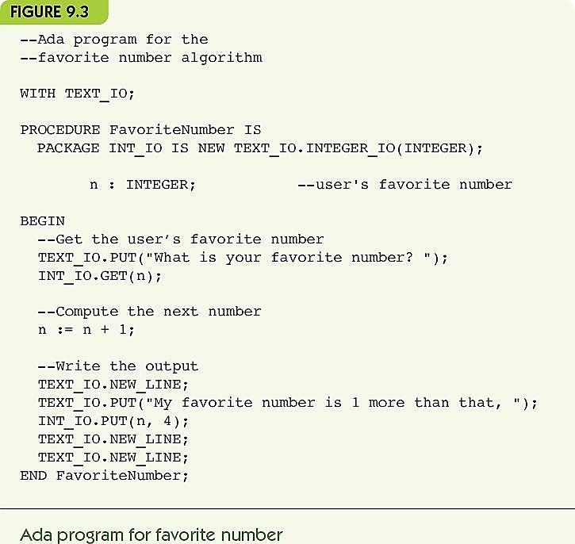
Two Examples in Five-Part Harmony (3 of 8)

Slide 12
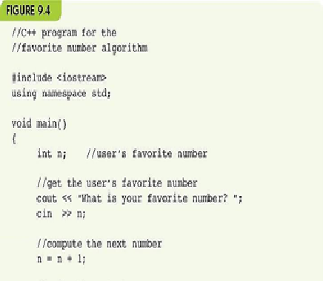
Two Examples in Five-Part Harmony (4 of 8)

Slide 13
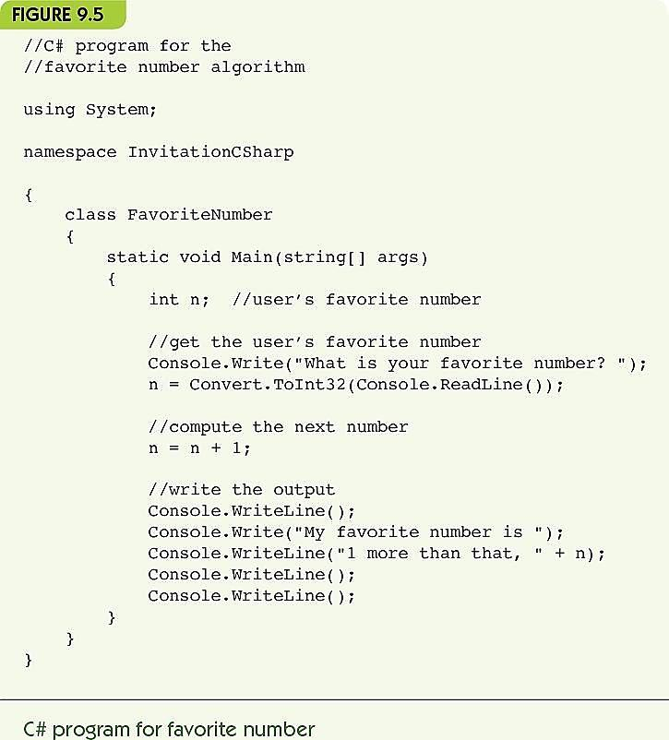
Two Examples in Five-Part Harmony (5 of 8)

Slide 14
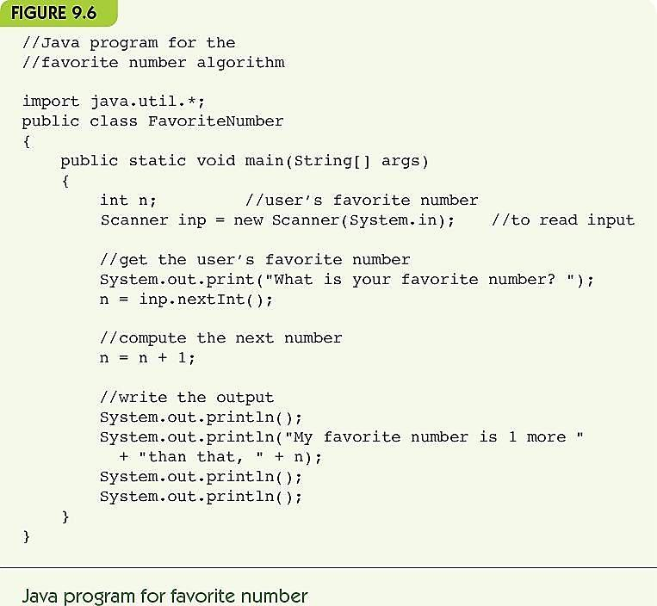
Two Examples in Five-Part Harmony (6 of 8)

Slide 15
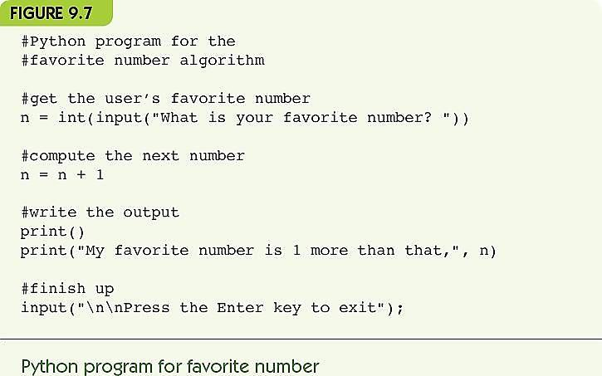
Two Examples in Five-Part Harmony (7 of 8)

Slide 16
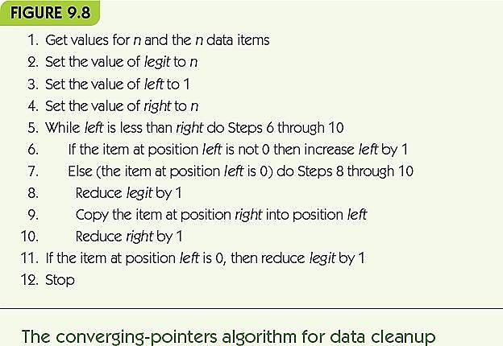
Two Examples in Five-Part Harmony (8 of 8)
Second example: Data Cleanup, Converging Pointers
Focus on loops and conditionals

Slide 17
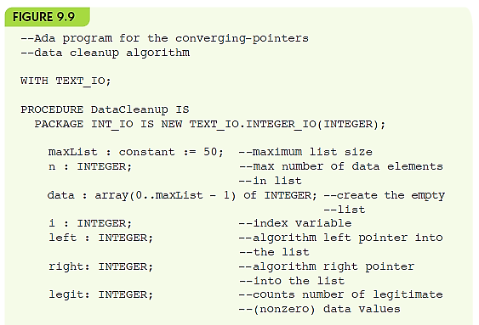
Figure 9.9 Ada converging-pointers algorithm (part 1)

Slide 18
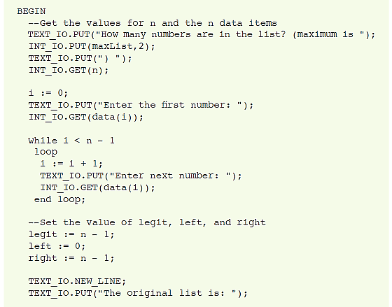
Figure 9.9 Ada converging-pointers algorithm (part 2)

Slide 19
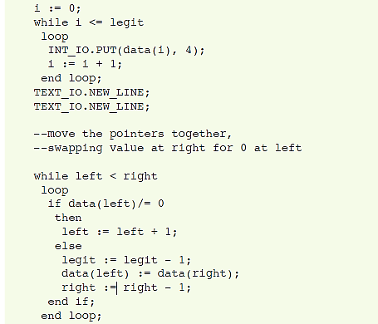
Figure 9.9 Ada converging-pointers algorithm (part 3)

Slide 20
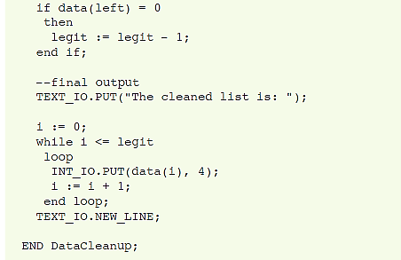
Figure 9.9 Ada converging-pointers algorithm (part 4)

Slide 21
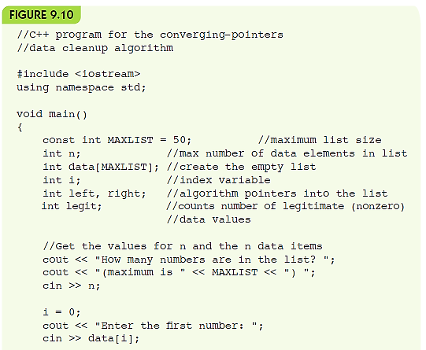
Figure 9.10 C++ converging-pointers algorithm (part 1)

Slide 22
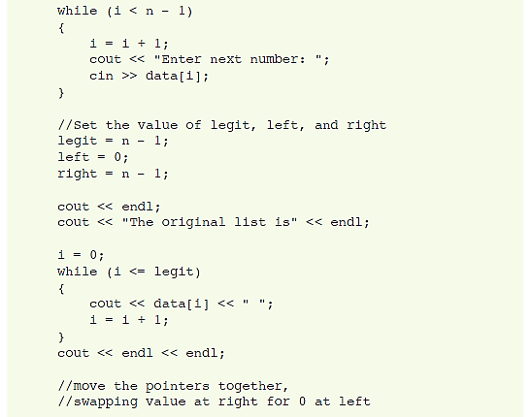
Figure 9.10 C++ converging-pointers algorithm (part 2)

Slide 23
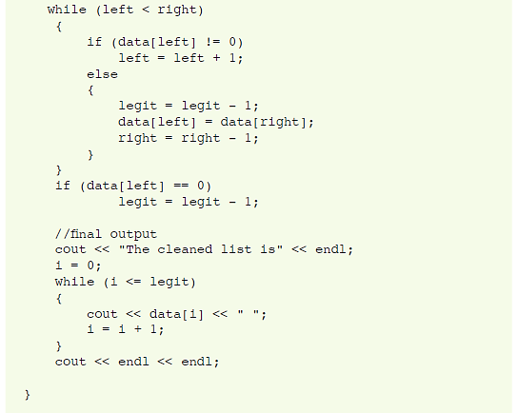
Figure 9.10 C++ converging-pointers algorithm (part 3)

Slide 24
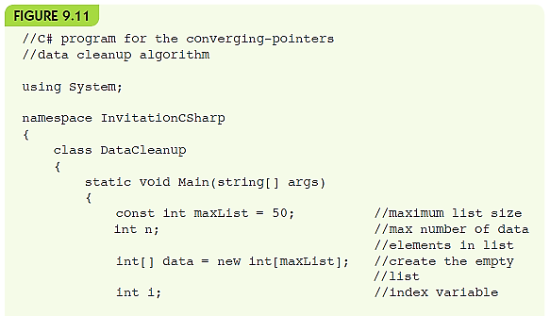
Figure 9.11 C# converging-pointers algorithm (part 1)

Slide 25
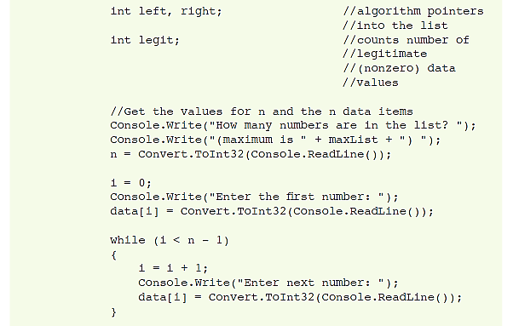
Figure 9.11 C# converging-pointers algorithm (part 2)

Slide 26
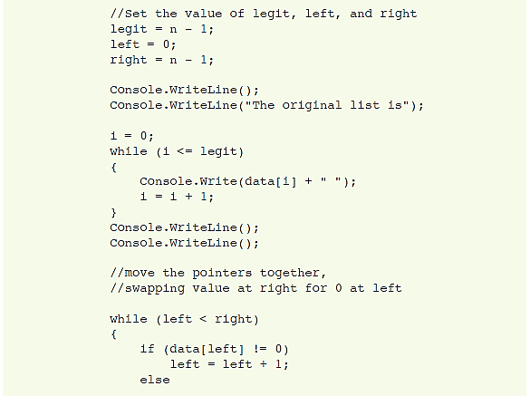
Figure 9.11 C# converging-pointers algorithm (part 3)

Slide 27
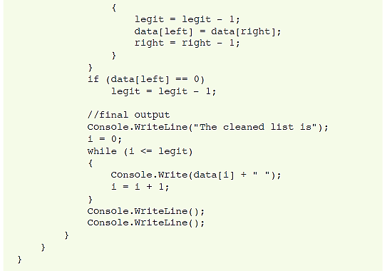
Figure 9.11 C# converging-pointers algorithm (part 4)

Slide 28
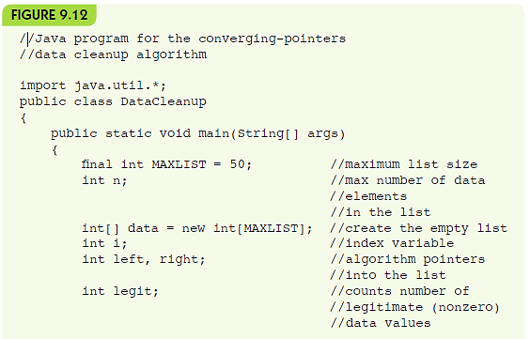
Figure 9.12 Java converging-pointers algorithm (part 1)

Slide 29
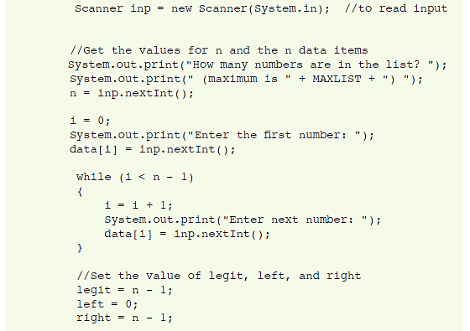
Figure 9.12 Java converging-pointers algorithm (part 2)

Slide 30
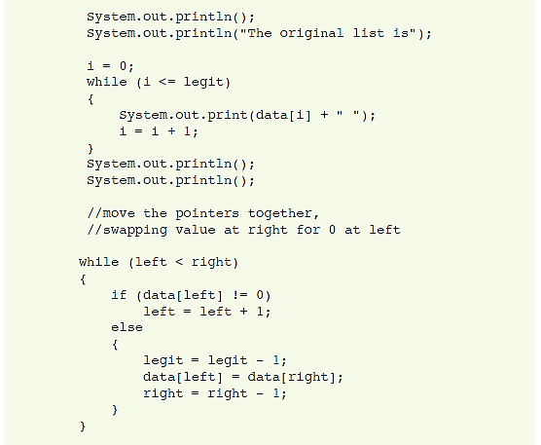
Figure 9.12 Java converging-pointers algorithm (part 3)

Slide 31
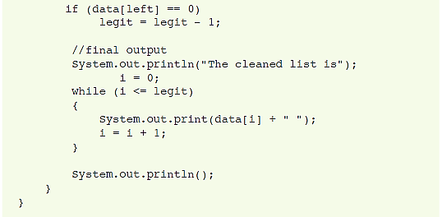
Figure 9.12 Java converging-pointers algorithm (part 4)

Slide 32
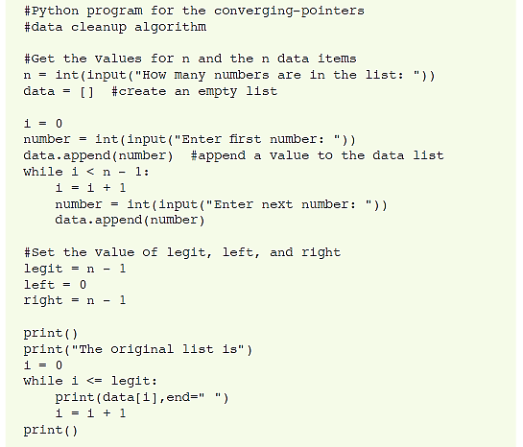
Figure 9.13 Python converging-pointers algorithm (part 1)

Slide 33
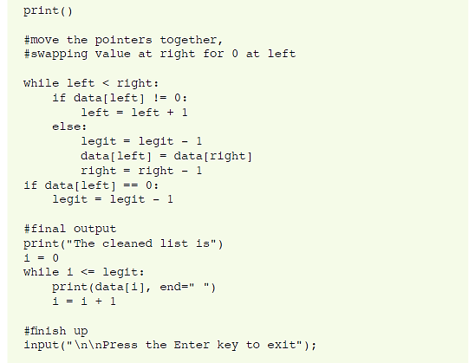
Figure 9.13 Python converging-pointers algorithm (part 2)

Slide 34
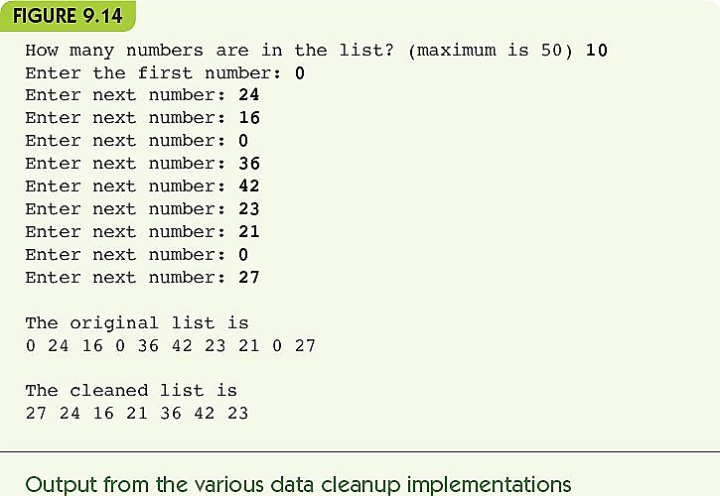
Two Examples in Five-Part Harmony

Slide 35
Feature Analysis
Compare pseudocode and language features
Syntax
Differences in describing data or variables
Differences in grouping things, making loops or conditionals
Semantics
Meaning of function call
Meaning of operations
Deeper structure
Modules, classes, and scope

Slide 36
Meeting Expectations (1 of 3)
Programmer need not manage data in memory
In each language, programmers must declare or create names (and sometimes types) for variables
Program manages movement of data associated with a given variable name
Macroscopic view of tasks (e.g., “Find the circumference of a circle if the radius is X”)
Languages provide statements for high-level math
Details of conditionals and loops are hidden

Slide 37
Meeting Expectations (2 of 3)
Programs are portable from one machine to another
Programming languages are standardized
Compiled languages (Ada, C++, Java, and C#)
Compilers written for a particular platform support standards and translate to machine-specific forms
Programmers distribute executable or low-level “bytecode”, not source
Interpreted languages (like Python) require an interpreter on each machine and distribute source code

Slide 38
Meeting Expectations (3 of 3)
Programming statements are closer to natural language and use mathematical notation
Mathematical notation is fairly standard across languages
Conditionals and loops are closer to natural language than assembly language

Slide 39
The Big Picture: Software Engineering (1 of 11)
Software development life cycle
Process required to create large-scale software projects
25 to 40 percent of time spent on problem specification and program design
10 to 20 percent of time spent on initial implementation
40 to 65 percent of time spent reviewing, modifying, fixing, and improving software

Slide 40
The Big Picture: Software Engineering (2 of 11)
FIGURE 9.16
Before Implementation
Feasibility study
Problem specification
Program design
Algorithm selection or development, and analysis
Implementation
Coding
Debugging

Slide 41
The Big Picture: Software Engineering (3 of 11)
After Implementation
Testing, verification, and benchmarking
Documentation
Maintenance
Steps in the software development life cycle

Slide 42
The Big Picture: Software Engineering (4 of 11)
Large software scale issues
Orders of magnitude larger than beginner programs
Compare one sentence to a 300-page novel
Software engineering
Development of large software projects
Requires collaboration, management, and organization
Formal processes for development

Slide 43
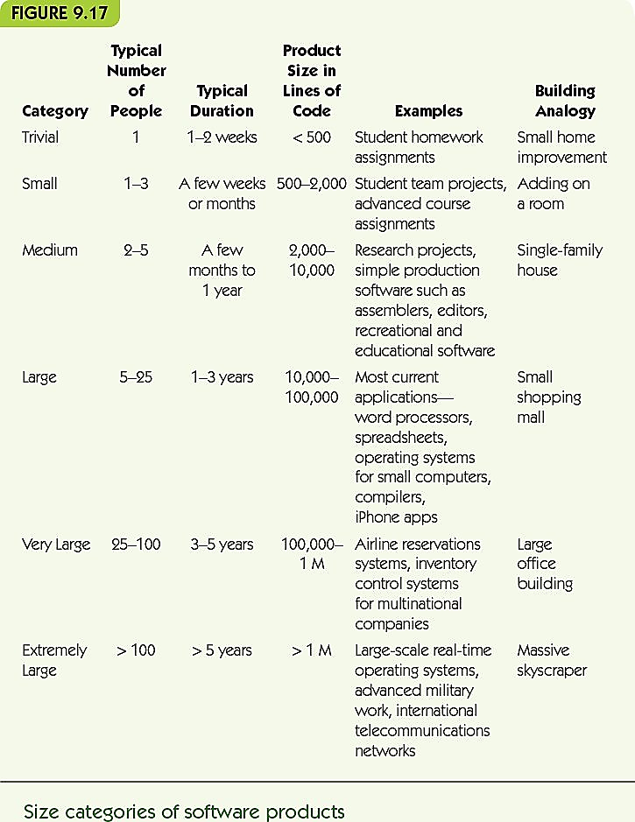
Figure 9.17 Size categories of software products

Slide 44
The Big Picture: Software Engineering (5 of 11)
Life cycle
Feasibility study
Assess costs and benefits
Consider alternatives
Problem specification
Clear statement of problem to be solved
Problem specification document

Slide 45
The Big Picture: Software Engineering (6 of 11)
Program design phase
Divide-and-conquer, top-down decomposition
Break problem into tasks and subtasks
Program design document
Algorithm selection or development and analysis
Choose or design an algorithm for each subtask
Analyze efficiency
Document: describe algorithm in pseudocode; provide efficiency analysis and rationale

Slide 46
The Big Picture: Software Engineering (7 of 11)
Coding
Translate pseudocode and design into working code
Better design = easier coding
Debugging: correcting program errors
Syntax errors: ungrammatical code statements
Runtime errors: illegal operations like dividing by zero
Logic errors: errors in the algorithm itself

Slide 47
The Big Picture: Software Engineering (8 of 11)
Testing, verification, and benchmarking
Empirical testing: develop a test suite to check correctness
Unit testing: test each module or subtask
Integration testing: test how modules work together
Regression testing: when a change occurs, test to be sure the change did not introduce errors
Program verification: to prove code is correct
Benchmarking: check performance on inputs

Slide 48
The Big Picture: Software Engineering (9 of 11)
Documentation
Internal documentation: comments in code
External documentation: all earlier documents (problem specification, program design, etc.)
Technical documentation: information for programmers to understand the code
User documentation: helps users run programs
Program maintenance
Add features, fix bugs, and improve performance

Slide 49
The Big Picture: Software Engineering (10 of 11)
Integrated development environment (IDE)
Program editor
File manager
Compiler or interpreter
Debugger
Prototypes
Rapid Prototyping
Version and document management

Slide 50
The Big Picture: Software Engineering (11 of 11)
Agile software development
Alternative to the waterfall model
Philosophy
Problem specification is never done
Change is expected, respond in agile way
Customer or user involved throughout process
Pair programming: two programmers at one computer
Code writer and observer roles are switched frequently

Slide 51
Summary (1 of 2)
High-level languages:
Hide details of memory and hardware operations
Enable code portability
Shift code statements toward natural language and mathematical notation
Programming languages may share an underlying philosophy but vary in syntax and semantics details
Ada, C++, C#, Java, and Python are all procedural languages

Slide 52
Summary (2 of 2)
Development of large software is a different kind of problem than writing a single algorithm.
Software development life cycles are designed to manage large software development.
Waterfall model starts with feasibility and problem specification and flows through debugging and testing.
Agile development moves quickly through the design-implement-test cycle, repeating it many times for a single project.

